Slide 1
IDF Strategy Mtg.
January 2019
Larry Lannom
Corporation for National Research Initiatives

Slide 2
DOI Directory (January 2019)
DOI Prefixes: 130,612 (includes 38,197 10.978 DOI prefixes and 63,326 10.979 DOI prefixes)
DOIs: >185,000,000
DOI Resolution Service
13 Handle Services (10 RAs + 1 Default for test etc + 1 extra for DataCite + 1 for 2 two-delimiter prefixes)
60 Individual Servers
Amazon Cloud Services
CoLo used by CNRI
Total Primary Servers: 24
16 managed by CNRI (6 CoLo, 10 cloud)
shortDOI server runs on one of those primaries
8 managed by various RAs
Total Secondary Servers: 36
35 managed by CNRI (10 CoLo, 25 cloud)
1 managed by an RA
All 60 servers are monitored by CNRI custom Nagios service plus commercial Pingdom service

Slide 3
DOI Resolution – Related Stats
DOI Resolutions in the past year: 5,138,961,801 (5 billion)
Proxy Servers (doi.org): Depending on the proxy load, servers are automatically scaled. Minimum 8 servers
2 servers in 4 regions managed by CNRI (4 regions on AWS Elastic Beanstalk)
All proxy servers and the DOI website servers are monitored by external system “Pingdom” and Nagios
Service disruption alerts are automatically sent to Statuspage and DOI Slack workspace

Slide 4
Proxy Service Infrastructure Upgrades
Successfully moved to Cloudflare mid-year as our authoritative DNS service.
Using Cloudflare’s load balancing and geographical routing features which depends on the client's geographical region to redirect the user to the geographically closest proxy server.
Replaced the old proxy servers with autoscaling clusters on AWS Elastic Beanstalk.
Automatic scaling to handle the DOI proxy server traffic.
Large decrease in manual effort to respond to outages
Large decrease in user impact of outages
Combination of load balancers and automatic health detection produced a significant service improvement in Q3 & Q4.

Slide 5
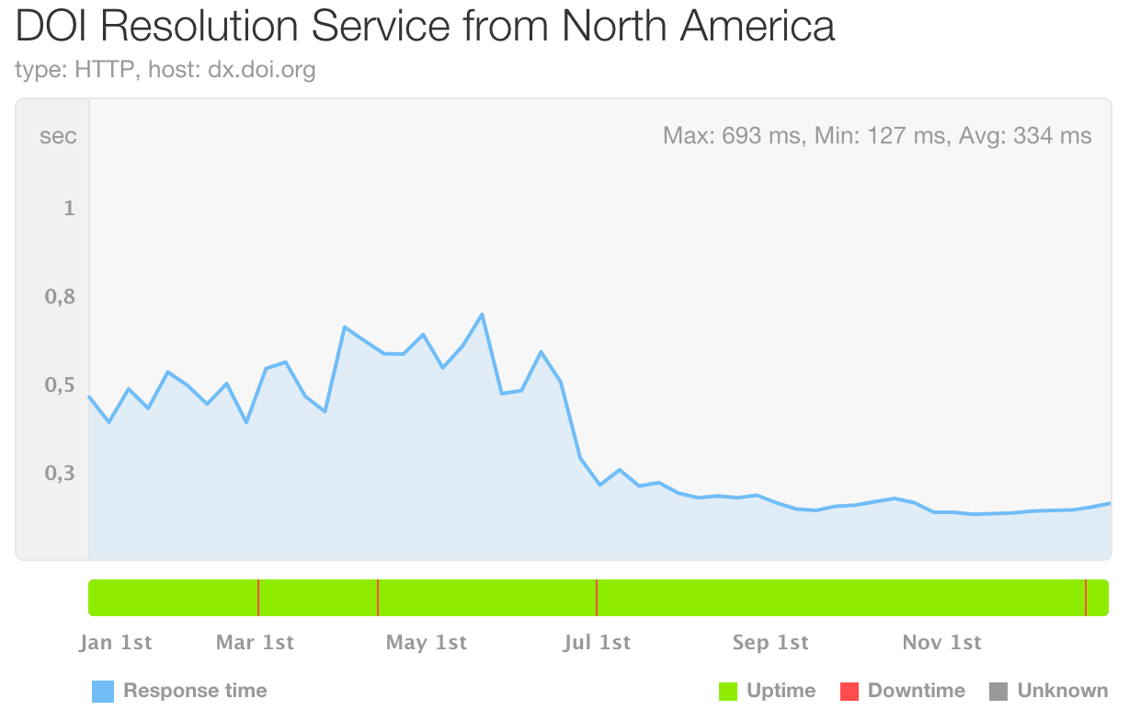
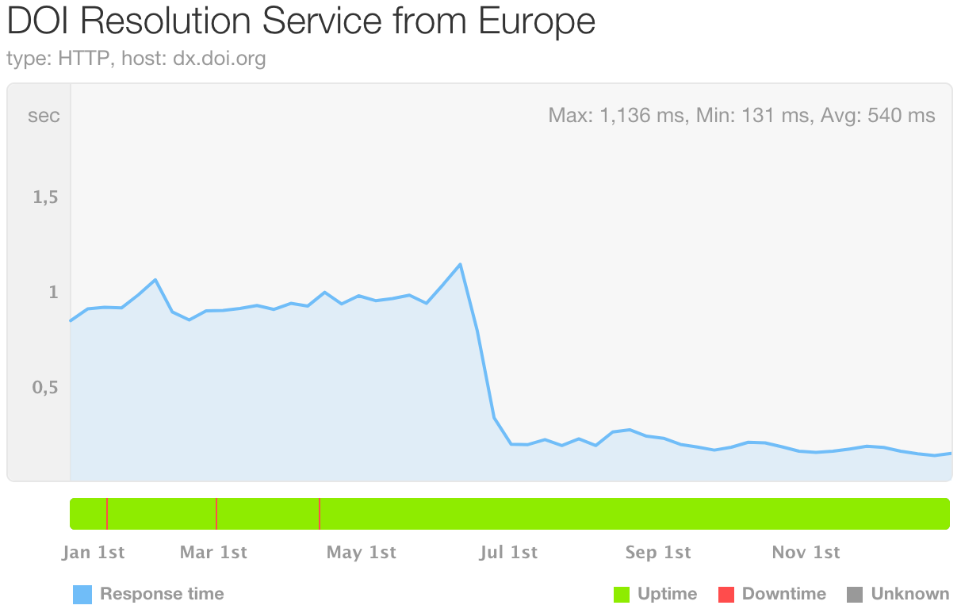
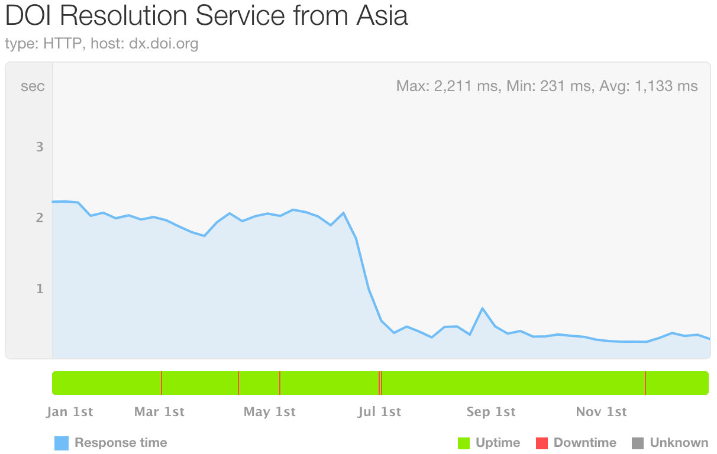
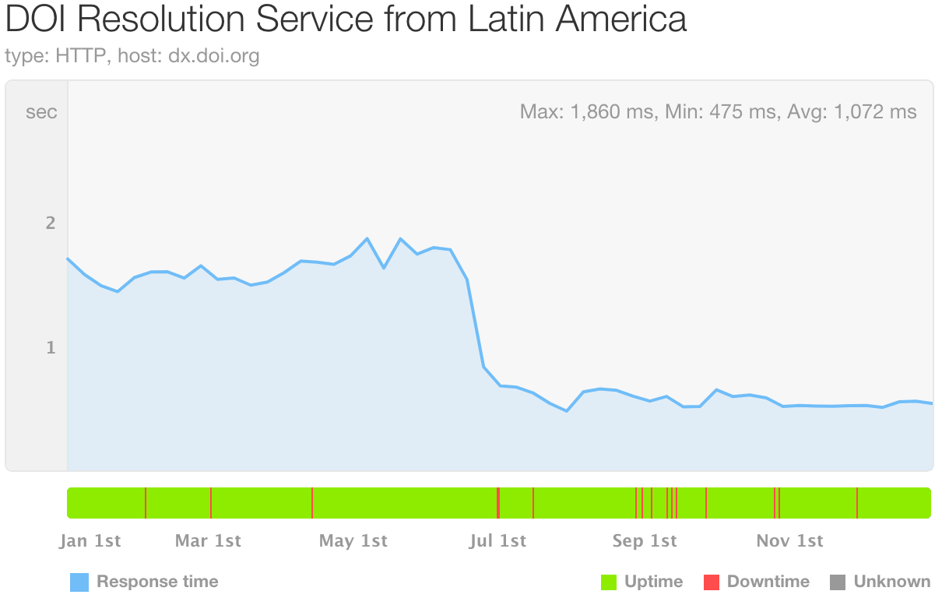
DOI Response Times (2018)
The four plots below show the DOI resolution response times as observed in different geographical regions. The plots clearly indicate when we switched Cloudflare in late June.
The red stripes on the green bar indicate downtime. More on this on the next slide.

Slide 6
DOI Resolution Service Downtime and Uptime (2018)
Downtime
Region | Pre-Cloudflare | Post-Cloudflare
North America | 2 hours (9 outages) | 2 minutes (2 outages)
Europe | 2 hours (4 outages) | None
Asia | 2 hours (10 outages) | 5 minutes (5 outages)
Latin America | 2 hours (11 outages) | 22 minutes (11 outages)
Uptime
Region | Pre-Cloudflare | Post-Cloudflare
North America | 99.96% | >99.99%
Europe | 99.96% | 100%
Asia | 99.96% | >99.99%
Latin America | 99.95% | 99.99%

Slide 7
Cloudflare December Stats Overview
Total requests through Cloudflare: 437M (December)
Cached Requests: 17M
Uncached Requests: 420M
Unique Visitors: 12.5M
Max unique visitors per day: 1M
Web traffic requests by country
United States: 183M
Germany: 52M
Ireland: 49M
China: 47M
UK: 16M
127 Challenged Requests (Dec)
Majority of them were human challenged (71%)
China (117 requests) and United States (10 requests)
* All numbers listed above are approximated to nearest million

Slide 8
Cloudflare Summary
Performance and stability increased with our use of Cloudflare.
This would also likely have been the case if we had moved to AWS CloudFront. But Cloudflare has more edge nodes across the world compared to other similar cloud services, and its DNS resolution speed is faster than other DNS providers.
http://www.dnsperf.com/
https://www.cdnplanet.com/compare/cloudfront/cloudflare/

Slide 9
Slack Workspace
DOI Foundation (doi-f) Slack Workspace with multiple channels was set up.
Extended Slack to use email both into and out of those Slack channels with the use of a SlackBot.
Created two channels: alerts and incidents, which are open only to DOI Foundation members, as part of an Incident Response system.
Alerts are auto-populated by Pingdom and Nagios monitoring services.
Enabled a private working group slack channel called “ra-fees”.

Slide 10
Monthly Reports
Successfully processed logs on a monthly basis, and provided monthly reports and ad hoc reports to RAs. CNRI generates these RA reports after analyzing usage logs of proxy servers.
Generated reports for past years upon request by several RAs.
Overall, nearly 200 usage reports were produced in 2018.
Reports contain raw logs plus summary report customized for each RA.

Slide 11
IDF Status Dashboard
IDF Dashboard: http://doi.statuspage.io
Continued to use Pingdom, an external monitoring service, which monitors the two most important services offered by IDF: DOI Resolution service and DOI Website.
Continued to use Statuspage for providing service updates/disruptions to the public at large.
Renewed our services for the upcoming year with Pingdom and Statuspage.

Slide 12
IDF Analytics
Continued to capture Google analytics reports of doi.org website. (Integrated back in Oct 2016).
2018 stats:
Visitors: 1.3M.
92% of traffic comes from desktop devices.
USA (18%), Brazil (18%), China (7%), Germany (5%), United Kingdom (4%).
Most popular pages: homepage, registration agencies, handbook and FAQ.

Slide 13
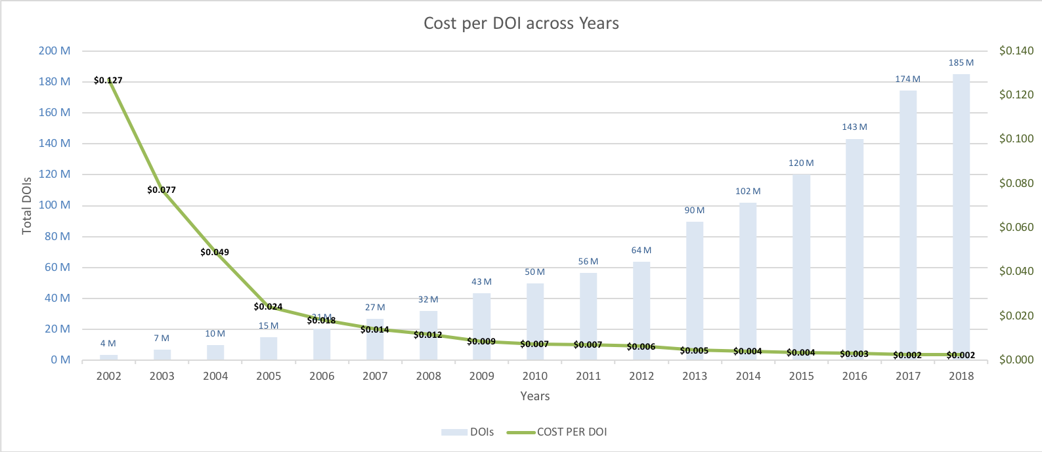
CNRI Technical Service Agreement Cost Mapped to Number of DOIs

Slide 14
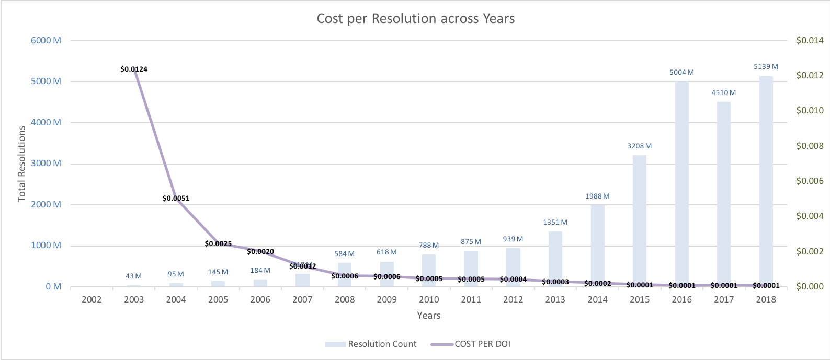
CNRI Technical Service Agreement Cost Mapped to Number of DOI Resolutions

Slide 15








CNRI Staff Working on DOI Tasks
Jane Euler
Suchitra Manepalli
Ben Hadden
Cathy Rey
Robert Tupelo-Schneck
Larry Lannom
Giridhar Manepalli
Ian Little

